Slide 1

THE FACULTY OF MEDICINE’S PROFESSIONAL VALUES…
AN EVOLUTION
Notes:
These slides educate faculty regarding the evolution of the Faculty of Medicine’s professional values initiated by the FOM Academic Strategic Plan (ASP) 2018-2023. While many of the traditional ethical and professional values of the University and large M Medicine (i.e. healthcare and its related academic disciplines) endure, critiques of professionalism have characterized it as a top down set of expected behaviours that measure one’s suitability to be “allowed in” to a profession.
In contrast, the evolution of professional values endorsed in the FOM’s ASP reflects:
important changes in society and within the healthcare environment
the increasing diversity of our learners and faculty and recognition of the need for our environments to be inclusive of all individuals
a growing understanding of the important role that workplace and academic environments play in both negatively or positively impacting faculty and learners’ mental health
A conceptualization that the relationships between professional values, wellness, and psychological and cultural safety are interdependent.

Slide 2

CONSIDER EQUIVALENT OF LAND ACKNOWLEDGEMENT
I (we) wish to acknowledge this land on which the University of Toronto operates. For thousands of years it has been the traditional land of the Huron-Wendat, the Seneca, and most recently, the Mississaugas of the Credit River. Today, this meeting place is still the home to many Indigenous people from across Turtle Island and we are grateful to have the opportunity to work on this land.
Image: David Loblaw
Notes:
PLEASE DON’T ADAPT THIS SLIDE WITHOUT CONSULTATION
If these slides are being presented in person we recommend using the University of Toronto land acknowledgement (see slide content)
However, as both the Faculty of Medicine’s Office of Inclusion and Diversity and Strategic Advisor on Indigenous Health have emphasized, it is important that the Acknowledgement is not mere tokenism, and that participants in educational activities are asked to take a moment to reflect on what this means in their own professional life and as a teacher. The Centre for Faculty Development has created an acknowledgement that they have used for online programs. They include the following passage:
We want to recognize that we are gathered in an institution with a colonial history and that we should work to address ongoing colonial harms. Land acknowledgements are only a starting point for larger conversations. More concrete acts of restitution and transformation are needed to address underlying inequities and blatant discrimination in the distribution of resources between Canada’s first peoples and settlers.

Slide 3
Learning Objectives
Inform faculty members of the importance of Professional Values within the Faculty of Medicine (FOM)
Describe the evolution of Professional Values within the FOM
Define and elucidate the links between the key professional values:
  wellness
  psychological
  cultural safety
  organizational justice
Describe the FOM policies and processes and resources that support Professional Values
Notes:
PLEASE DON’T ADAPT THIS SLIDE WITHOUT CONSULTATION
For some faculty, these concepts will be familiar, for others relatively new.
The facilitator may wish to explore with the group the variations in comfort level with these concepts, together with their response to the concepts being perceived as professional values by the Faculty
The facilitator will need to feel comfortable exploring potential cynicism regarding the Strategic Plan’s endorsement of these values. We recommend bringing the group back to what these mean for them and their colleagues in their work and learning environments.

Slide 4

FOM Academic Strategic Plan
(2018-2023)
Ecosystem of Collaboration
Actions:
Optimize our learning environments to deepen the integration of wellness, respect and resilience, including the promotion of professional values.
A learning environment that is welcoming and supportive across the continuum is integral to learner/trainee health and wellbeing.
Consider and address where possible how curricular structures and wellness/resiliency programming can enable and support the health and wellbeing of learners/trainees, faculty and staff.
Ensure there is clarity (and, where possible, harmonization/ integration) regarding relevant mistreatment policies, procedures, reporting practices/expectations, and corresponding supports.
Develop an integrated encounter/record information system.
Provide training/development opportunities to faculty, staff and students that is tailored to principles, roles and responsibilities.
Notes:
PLEASE DON’T ADAPT THIS SLIDE WITHOUT CONSULTATION
The Faculty of Medicine Academic Strategic Plan identified our learning environments as inextricably linked with wellness, respect, inclusion, and supported by our professional values
This reflects the importance that the FOM gives to these essential aspects of our professional lives.
Sometimes strategic plans can be perceived as “top down” but many of these recommendations were based in surveys of learners and faculty, as well as literature reviews and expert consultations on the subjects of wellness and engagement with one’s academic work and environment.

Slide 5
FOM Academic Strategic Plan
(2018-2023)
Excellence Through Equity
Create a community of leaders across the Faculty of Medicine that is held accountable to advance equity, diversity and inclusion
Embed principles of equity and inclusion into curricula and teaching across the Faculty to create a safe and healthy learning environment for all
Partner with Indigenous communities, patients and across TAHSN to deliver on the recommendations of the Truth and Reconciliation Commission
Action: Review and clarify policies, procedures, reporting processes and best practices in communication with respect to intimidation, discrimination and harassment, and improve alignment across the Faculty.
Notes:
PLEASE DON’T ADAPT THIS SLIDE WITHOUT CONSULTATION
Again, to make this real to participants, facilitators may wish to comment on the gaps between the status quo and these goals and invite participants to contribute what they see as mechanisms for closing gaps within their Department/Program/Classrooms/Labs/Research Institutes/Hospitals.
Encourage them to stay focused on what they can do as teachers/administrators/mentors, and on how the University can support their actions.
While clinical environments are obviously also places where professional values are essential, we are looking primarily in this educational activity on faculty’s roles as University teachers.

Slide 6
Professional Values
According to the Oxford English Dictionary, values are the principles or moral standards held by a person or social group.
Within our academic and clinical settings, shared norms, values, and expectations help to describe and support the behaviours expected of learners and physicians by one another, by the medical profession, by our healthcare professional colleagues, by our patients and their families, and by society – these are collectively known as our professional values.
Professional values are commitments that individuals keep even in challenging situations.
Notes:
PLEASE DON’T ADAPT THIS SLIDE WITHOUT CONSULTATION
The facilitator may wish to explore how the group would identify their department’s/team’s/hospital’s/lab’s shared norms, values, and expectations; how these are made known; whether or not they are viewed as meaningful and authentic; how they are or are not supported by individuals, institutions, leaders, etc.

Slide 7
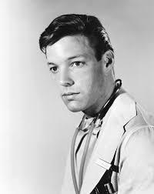
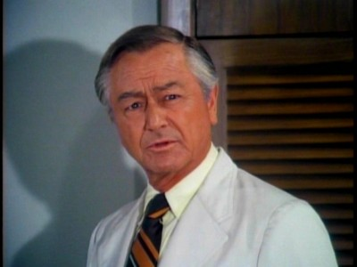
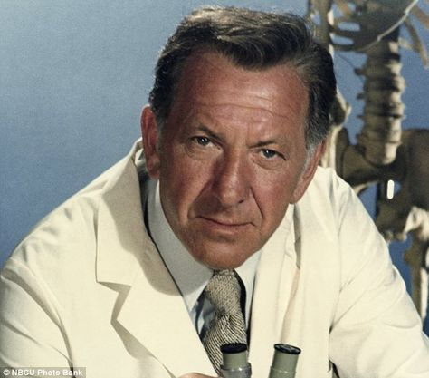
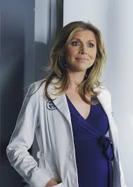
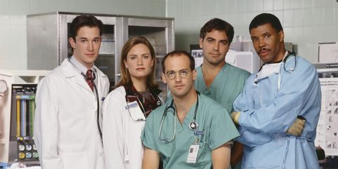


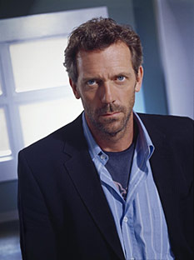
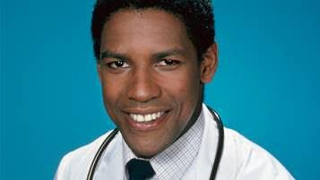
Professional Values Evolve…
Notes:
Clockwise from top left
Dr. Kildare (played by Richard Chamberlain) novels 1930s, TV show 1960s
Dr. Gregory House (played by Hugh Laurie, 2004-2012)
Dr. Marcus Welby (played by Robert Young 1969-1976)
Grey’s Anatomy (2005-present)
Transplant (2020 Bash played by Hamza Haq, 2019 Canadian)
Dr. Elliot Reid ( played by Sarah Chalke, Scrubs 2001-2010)
ER (1994-2009)
Dr. Philip Chandler, St. Elsewhere (played by Denzel Washington, 1982-1988)
Quincy (played by Jack Klugman, 1976-1983)
These depict the evolution of idealized television physician heroes/anti-heroes over time.
For non-medical clinicians and for scientists, it would be helpful to compile a similar collection of images from popular media to demonstrate the point.
If sufficiently familiar, this slide can be used as an enjoyable quiz that also illustrates generational differences among department members in terms of which characters they recognize.

Slide 8
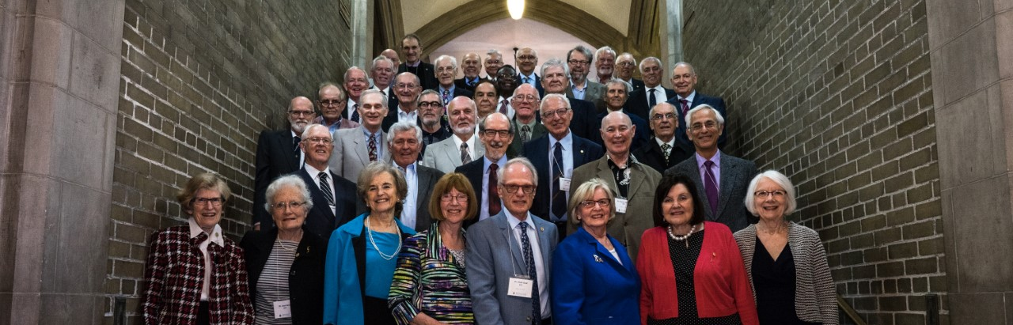
Professionalism past…
Notes:
U of T MD CLASS 1967

Slide 9
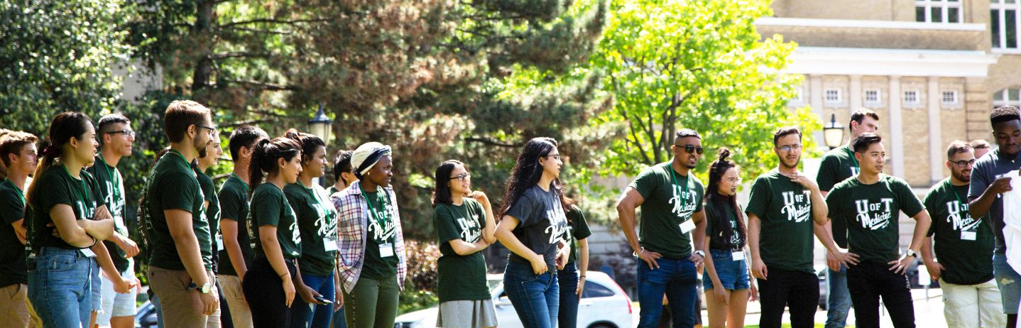
Professionalism future…
Notes:
MD Program Class 2T3
(may want to update)

Slide 10
EQUIVALENT IMAGES FOR RSI, OTHER DEPARTMENTS

Slide 11
What’s the same?
Professional and University Regulatory/Labour Frameworks
Codes of Ethics
Generation Gaps vs Cohort/Developmental/Individual Characteristics – myth and reality
Importance of Role Modelling
Majority adhere
Minority don’t
Notes:
PLEASE DON’T ADAPT THIS SLIDE WITHOUT CONSULTATION
This slide attempts to point out that not everything about Professional values shifts
The facilitator may wish the group to fill in gaps – what do they see as persistent in terms of how professional values are developed, understood, conveyed, and adhered to…in their Department
The issue of Generation gaps vs individual/developmental/cultural and cohort characteristics is controversial. Every generation in medicine is convinced that the younger generation is less capable, less hard working, less dedicated, with historical documents testifying to an eerie similarity to the concerns raised. The data to suggest true generational differences is weak (Jauregui J, Watsjold B, Welsh L,
Ilgen JS, Robins L. Generational “othering”: The myth of the Millennial learner. Med Educ. 2020;54:60–65. https ://doi.org/10.1111/medu.13795; National Academies of Sciences, Engineering, and Medicine. 2020. Are Generational Categories Meaningful Distinctions for Workforce Management?. Washington, DC: The National Academies Press. https://doi.org/10.17226/25796.
However individual discussions of cohort and cultural experiences and developmental/life stages may be useful discussion points. For example a racialized early career faculty member with young children with lived experience of the societal racism and violence that gave rise to Black Lives Matter is likely to have a different perspective on a number of relevant issues from a late stage career white faculty member whose children are adults and who has only recently been fully exposed through the media to the type of racism that Black Lives Matter has attempted to shed light on.

Slide 12

What’s different?
Millenials/Gen Z – cohort experiences
  Me Too
  Black Lives Matter
  TRC
  Financial pressures
  Flattened hierarchy
Speaking Up on Learner Mistreatment
Pit Crews not Cowboys*
Culture Wars
Focus on Wellness & Burnout
Notes:
PLEASE DO NOT ADAPT THIS SLIDE WITHOUT CONSULTATION
This is a chance to review with the group how they see wider societal influences impacting the evolution of professional values
As with the previous slide, it points to the difference between conceptualizing generation gaps (which tend to be unsupported by data) in favour of reflecting on individual differences which may include the developmental life stage, cohort experiences, cultural backgrounds, which are genuinely impacted by societal/cultural/global events and trends.
Facilitators speaking to research and basic science audiences may want to add changes in their fields that have had impact.
TRC = Truth and Reconciliation Commission
* Pit Crews not Cowboys reference by Atul Gawande. While article focuses on healthcare, this is also relevant to research teams and collaborations https://www.newyorker.com/news/news-desk/cowboys-and-pit-crews

Slide 13


Refreshing our professional values…
Psychological Safety
Cultural Safety
Organizational Justice
Wellness
Notes:
PLEASE DO NOT ADAPT THIS SLIDE WITHOUT CONSULTATION
This slide summarizes how the preceding slides necessitated a “refresh” to the FOM’s professional values focused on Respect, Civility, Equity, Diversity, and Inclusion, Organizational accountability, and increased focus on mental health and prevention of burnout for both faculty and learners, in order to reflect the Academic Strategic Plan which gave a voice to today’s faculty and learners while aligning with societal change.

Slide 14
Why link PV and Wellness?
“Think ill before evil…”
Mental health challenges contribute to:
  Increased Absenteeism
  Impaired Work Performance
  Negative Staff Attitudes and Behaviours
  Impaired Relationships at Work
      World Health Organization, “Mental Health and Work”, 2000
Notes:
PLEASE DON’T ADAPT THIS SLIDE WITHOUT CONSULTATION
This slide reviews the link between mental health and work, and between mental health and professional behaviours and attitudes

Slide 15
How do we get to where we need to go?
Implement Organizational Justice framework to ensure organizational accountability
Create robust disclosure/reporting pathways for breaches of professional standards which align with Natural Justice
Renew our professional values to include wellness, anti-racism, EDI, TRC
Support (and enforce) psychologically safe educational spaces and workplaces
Notes:
PLEASE DON’T ADAPT THIS SLIDE WITHOUT CONSULTATION
This slide looks at what concrete steps need to be taken to support these refreshed professional values

Slide 16
Organizational Justice Framework
the equity in the rules and social norms that govern organizations
fairness and trust
a consistent and strong predictor of job satisfaction
protects against psychological distress
Notes:
PLEASE DON’T ADAPT THIS SLIDE WITHOUT CONSULTATION
This slide looks broadly at the University’s obligation to provide faculty, learners and staff with a organizational context that is just. This emphasizes the key concept of professional values as community and organizational obligations, rather than simply living within individuals and relationships.
Slide provided kindness of Bonnie Kirsh

Slide 17
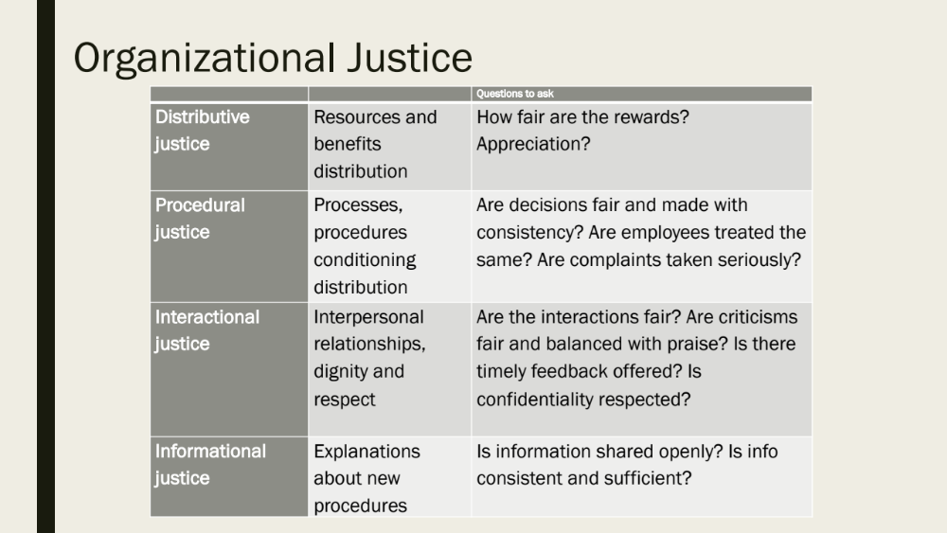
Notes:
PLEASE DON’T ADAPT THIS SLIDE WITHOUT CONSULTATION
This expands on the prior slide and links procedural justice (how are individuals treated, particularly in the context of a complaint) within the larger framework of organizational justice that supports professional values at an institutional level.
Slide provided kindness of Bonnie Kirsh

Slide 18
Why Does Organizational Justice Matter?
association between perceived justice and wellbeing amongst physicians in Finland (Elovainio et al., 2015)
ratings of interactional justice from Canadian nurses showed those with greater feelings of respect had greater job satisfaction, lower emotional exhaustion (Laschinger, 2004)
perceptions of justice in scientific workplaces (organizational justice) are positively associated with self-report of "ideal" behaviors and negatively associated with self-report of misbehavior and misconduct (Martinson et al., 2010)
Notes:
PLEASE DON’T ADAPT THESE SLIDES WITHOUT CONSULTATION
While this evidence is drawn from clinical contexts, it also lends itself extrapolation to labs and academic environments

Slide 19
Natural Justice/Procedural Fairness
Natural justice (also referred to as procedural fairness) is a concept entrenched in Canadian law as the legal right to be treated fairly in any administrative proceeding.
For clinicians, this right is highly relevant when an individual faces regulatory authority (College) or hospital proceedings and for both clinicians and scientists when facing university sanctions
Notes:
PLEASE DON’T ADAPT THIS SLIDE WITHOUT CONSULTATION
The next set of slides transitions to looking at how the FOM supports its Professional Values with its policies, processes, and resources. This slide looks at the context imposed by Canadian law on all University policies and processes – known as Natural Justice or Procedural fairness

Slide 20
Natural justice: three key principles
  the right to be heard
  the right for adjudicators to be free from bias
  the right to receive reasons for any decision
Notes:
PLEASE DON’T ADAPT THIS SLIDE WITHOUT CONSULTATION
Definition of natural justice
https://www.cmpa-acpm.ca/en/advice-publications/browse-articles/2018/understanding-your-rights-the-rules-of-natural-justice

Slide 21
Key FOM Policies
(clinical medical faculty)
The Policy for Clinical Faculty sets out relationships among physicians, the university, and hospitals generally; and mandates rights of clinical (MD) faculty to academic freedom and fair treatment;
The accompanying Procedures Manual for the Policy of Clinical Faculty describes in detail faculty and university responsibilities, and the structures and processes that enable faculty rights;
Standards of Professional Behaviour for Medical Clinical Faculty
Notes:
PLEASE ADAPT THIS SLIDE WITH INFORMATION RELEVANT TO YOUR DEPARTMENT MEMBERS
Slides 32 to 40 describe the policies that support professional values within the FOM and reference FOM, university, and regulatory. They are relevant to Medical Clinical Faculty and need to be replicated with relevant information for non medical clinical and scientific and teaching faculty.

Slide 22
Standards of Professional Behaviour for Medical Faculty (revised April 2020):
What’s new?
Clarification of roles; emphasis on collaboration with clinical partners
Increased emphasis on EDI, TRC
Removal of overlapping content
Compliance with University’s Sexual Violence and Harassment Policy
Disclosure vs reporting
Recognition of impact of power imbalances
Emphasis on safety for those disclosing
Increased focus on monitoring and responding to retaliation
Notes:
PLEASE DON’T ADAPT THIS SLIDE WITHOUT CONSULTATION
While this Standards Document applies only to the Medical Clinical Faculty, it clearly articulates FOM expectations Professional Standards for all faculty members.

Slide 23
Key Regulatory Policies:
(CPSO)
Physician Behaviour in the Professional Environment
Professional Responsiblities in Postgraduate Medical Education
Professional Responsiblities in Undergraduate Medical Education
Social Media – Appropriate Use by Physicians
Mandatory and permissive reporting
Notes:
PLEASE ADAPT THIS SLIDE WITH INFORMATION RELEVANT TO YOUR DEPARTMENT MEMBERS
These policies are relevant only to medical clinical faculty. Other Departments where members have their own regulatory colleges will wish to cite their own.

Slide 24
Key Policies:
(University)
Other broader University of Toronto policies are relevant to all faculty within the Faculty of Medicine:
Policy on Sexual Violence and Harassment and the related Protocol with Affiliated Sites
Relationships with Industry and the Educational Environment in Undergraduate and Postgraduate and Undergraduate Medical Education
Policy on Ethical Conduct in Research
Code of Behaviour on Academic Matters
Statement on Prohibited Discrimination and Discriminatory Harassment
Framework for Addressing Allegations of Research Misconduct, included the related Addendum for affiliated Health Sites
Notes:
PLEASE DON’T ADAPT THIS SLIDE WITHOUT CONSULTATION
These policies are relevant to all faculty with University appointments.

Slide 25
Consultation
Resources:
(University)
FOM Director of Professional Values
Faculty Advocate (Medical Clinical faculty)
FOM Director of Learner Experience*
FOM Legal Counsel
FOM Faculty Wellness Lead
Department Chair, Vice Chairs
University Division Directors
FOM Office of Inclusion and Diversity
U of T Centre for Sexual Violence, Prevention, and Support Centre
U of T Anti-Racism Office
U of T Centre for Teaching Support and Innovation
FOM Centre For Faculty Development
Coaching resources
Notes:
THESE RESOURCES ARE AVAILABLE TO ALL FACULTY MEMBERS WITH THE EXCEPTION OF THE DIRECTOR OF LEARNER EXPERIENCE WHO CURRENTLY CONSULTS ONLY TO MEDICAL LEARNERS

Slide 26
Consultation Resources:
(clinical sites)
Hospital Chief
Hospital Division Director
VP Medical
VP Education
VP Legal
HR
Notes:
THESE RESOURCES ARE RELEVANT TO MEDICAL CLINICAL FACULTY
Please replace with your own departmental/University resources where relevant

Slide 27

Why link PV with psychological safety?
erhui1979/iStock
Notes:
PLEASE DON’T ADAPT THIS SLIDE WITHOUT CONSULTATION
The facilitator may wish to ask participants their thoughts on this.
It will be helpful to share work that has demonstrated the link between high performing teams and a team culture that promotes Psychological Safety. This work has been replicated in healthcare, at Google, in the airline industry, and in the classroom (motivated and engaged learners).
REFS: Edmonson, A. (1999) Psychological Safety and Learning Behaviour in Work Teams, Administrative Science Quarterly, Vol. 44, No. 2 (Jun., 1999), pp. 350-383. http://www.jstor.org/stable/2666999
Edmonson, A. (2018, Nov 14) How Fearless Organizations Succeed. Strategy + Business. https://www.strategy-business.com/article/How-Fearless-Organizations-Succeed?gko=63131
Frankel A, Haraden C, Federico F, Lenoci-Edwards J. A Framework for Safe, Reliable, and Effective Care. WhitePaper. Cambridge, MA: Institute for Healthcare Improvement and Safe & Reliable Healthcare; 2017
Gawande, A. (May 26, 2011) Cowboys and Pit Crews. The New Yorker, https://www.newyorker.com/news/news-desk/cowboys-and-pit-crews
Medical professionalism in a changing world. Report of a Working Party of the Royal College ofPhysicians of London. London: RCP, 2005.
National Academies of Sciences, Engineering, and Medicine. 2018. How People Learn II: Learners, Contexts, and Cultures. Washington, DC: The National Academies Press. https://doi.org/10.17226/24783.

Slide 28
5-Minute Psychological Safety Audit
If you make a mistake in this team will it be held against you?
Are the members of this team able to bring up problems and tough issues?
Do people on this team sometimes reject others for being different?
Is it safe to take a risk on this team?
Is it difficult to ask other members of this team for help?
Would anyone on the team deliberately act in a way that undermines efforts?
Working with members of this team, are unique talents and skills valued and utilized?
        Edmonson, A. (1999) Psychological Safety and Learning Behaviour in Work Teams, Admin Sci Quarterly, 44; 350-383
Notes:
PLEASE DON’T ADAPT THIS SLIDE WITHOUT CONSULTATION
Facilitator can ask participants on whether there learning and/or work environment meets this safety audit.
It will be important to emphasize confidentiality within the group and the fact that people may prefer to reflect silently as this may raise sensitive issues, particularly if participants work together.

Slide 29
Psychological Safety: Leadership
Three essential actions described for leaders and institutions to establish psychological safety:
frame work as a shared learning problem where we face uncertainty and interdependence
acknowledge own fallibility
model curiosity
Lead with courage
Invite connections
Notes:
PLEASE DON’T ADAPT THIS SLIDE WITHOUT CONSULTATION
Again, ask individuals to consider leadership within their departments, as well as their own small l leadership. Do they do this?
Same caveats re psychological safety within this specific educational activity apply.
Refs. Ibid; https://trainingindustry.com/articles/leadership/inclusive-leadership-the-role-of-psychological-safety/

Slide 30

Why link PV with cultural safety?
© Romolo Tavani / stock.adobe.com
Notes:
PLEASE DON’T ADAPT THIS SLIDE WITHOUT CONSULTATION
Cultural safety is an integral aspect of psychological safety. If a work/learning environment is not inclusive, it is not psychologically safe for all members,and similarly will not be performing optimally. This discussion of workplaces requires expertise on the part of the facilitator with regard to ensuring the safety of all members, particular participants from structurally marginalized groups. If the facilitator does not have training/expertise, these are available through the FOM’s Office of Inclusion and Diversity

Slide 31
Clinical Departments:
Challenges
Hierarchy of healthcare
History of gender-based roles for healthcare professionals
Apprenticeship model means learners dependent on supervisors for reference letters
Pressures of the healthcare environments
Challenges from patients and families
Notes:
PLEASE DON’T ADAPT THIS SLIDE WITHOUT CONSULTATION. MAY DELETE IF NOT RELEVANT TO YOUR DEPARTMENT
This slide encourages Clinical Departments to consider unique aspects of their educational environments that may challenge psychological and cultural safety

Slide 32
Basic Science Departments:
CHALLENGES
Unique vulnerability of graduate students?
Age range of learners
Productivity pressures
Other challenges?
Notes:
PLEASE DON”T ADAPT THIS SLIDE WITHOUT CONSULTATION . MAY DELETE IF NOT RELEVANT TO YOUR DEPARTMENT
This slide encourages Basic Science Departments to consider unique aspects of their educational environments that may challenge psychological and cultural safety

Slide 33
Faculty wellness resources
Physician Health Program
Hospital Human Resources/EAP
FOM COVID Resource Navigator
CAMH
Notes:
Again, these resources are relevant to medical clinical faculty. Other departments can access the FOM Wellness Case Navigator for assistance identifying relevant resources. https://medicine.utoronto.ca/wellness-resources-faculty

Slide 34
Key Wellness Resources: (National/Provincial)
CMPA
CPSO
CMA (private therapy)
Physician Health Program
Hospital HR/EAP
Notes:
THESE RESOURCES ARE RELEVANT FOR MEDICAL CLINICAL FACULTY. MAY DELETE IF NOT RELEVANT TO YOUR DEPARTMENT
Consider resources relevant for your own department.

Slide 35
Scenarios
Faculty Learner
Faculty Faculty
Faculty Administrative staff
Patient Faculty
Patient Learner
Faculty Healthcare Professional
Notes:
Scenarios are found in the Essentials Guide with recommendations for how to ensure simulations are psychologically and culturally safe for participants. Alternatively the group could be asked to come up with their own.

Slide 36

“The arc of the moral universe is long, but it bends toward justice.”
Notes:
Barack Obama via MLK Junior
Again this quote emphasizes professional values as a community obligation rather than simply an individual one. Both individual and community/institutional action are necessary for the arc to continue to bend…

